Slide 1

Reservoir injection schemes
Do not adjust the width of this textbox, just type within it
Team №2
Yana Snegireva
Fomichev Egor
Alina Khayrullina
Tatiana Alekhina
Damir Akhmetov
Danil Sherki

Slide 2
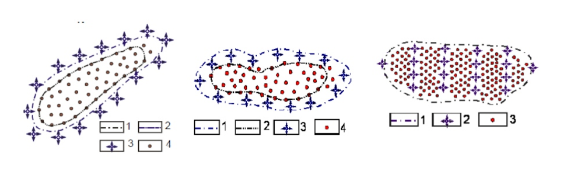
Flooding types
Edge flooding
Marginal flooding
Boundary flooding
1 - outer contour of oil bearing capacity
2 - inner oil pool outline
3 - injection well
4 - production well
Notes:
Scientific description (Слава)
These annual losses represent approximately 20% of the initial meat production (304.2 million tons). These losses are essentially due to spoilage, characterized by a decrease in the sensory quality of the meat products
CV has several advantages over the traditional methods. It is non-destructive, easy, and quick, more efficient in meat quality assessments.

Slide 3


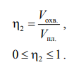
Main features
oil recovery factor
value of residual oil saturation after oil displacement from the core with water
LAB METHOD
initial water saturation in the core
displacement factor
displacement coverage factor
oil displacement factor by water in different geological and physical conditions varies from 0.4 to 0.75
the ratio of the displaced oil volume to the original oil volume in the reservoir covered by the displacement process
the coverage factor characterizes the share of the reservoir covered by the displacement process and is defined as the ratio of the volume of the reservoir covered by the displacement process to the entire volume of the reservoir

Slide 4
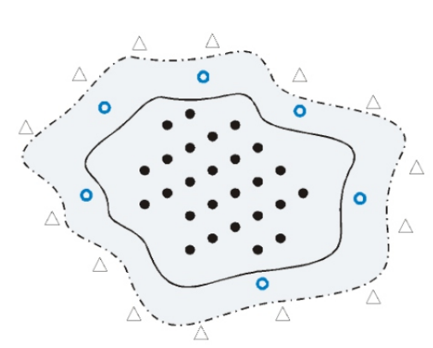
Edge flooding
injection wells are located 300 - 800 m from the outer oil pool outline
with good hydrodynamic connection of the reservoir and injection wells
with the relatively small size of the oil deposit
in a homogeneous reservoir with sandstone or siltstone
permeability 0,3-1 Darcy
fluid viscosity <5 mPa*sec
outer oil pool outline
inner oil pool outline
control wells
production wells
production well
Disadvantages
water losses
accelerated lifting of Oil-Water contact
low oil displacement factor in center
low pace of development (3%)
Notes:
Scientific description (Слава)
These annual losses represent approximately 20% of the initial meat production (304.2 million tons). These losses are essentially due to spoilage, characterized by a decrease in the sensory quality of the meat products
CV has several advantages over the traditional methods. It is non-destructive, easy, and quick, more efficient in meat quality assessments.

Slide 5
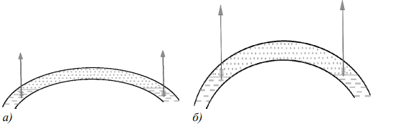
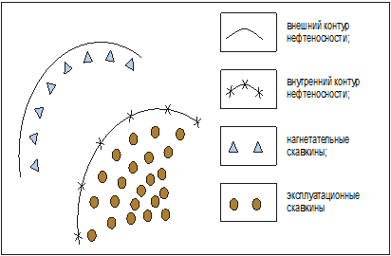
Marginal flooding
the same restrictions as for the edge flooding, but with worse hydrodynamic connections between the oil-saturated part and the water-bearing area
Injection wells are drilled in the water-oil zone of the reservoir between inner and outer contours oil-bearing area;
for formations with greatly reduced permeability permeability in the outermost part;
in case of deteriorated hydrodynamic of the reservoir to the outer area;
at relatively small dimensions of the reservoir
Edge flooding
Marginal flooding
outer contour of oil bearing capacity
inner contour of oil bearing capacity
Injection wells
Producing wells
Notes:
Marginal flooding applied under the same restrictions as those adopted for the bottom-hole flooding, but with deteriorated hydrodynamic connections between the oil-saturated part and the water-bearing area.
Marginal flooding can be regarded as a less intensive type of intracircuit flooding with all its inherent disadvantages. In the process of development, watering of the production takes place. As a rule, the wells located near the injection line are watered more intensively. In order to involve zones with deteriorated filtration-volumetric properties in the process of drainage and to increase the coefficient of formation coverage by influence, the consecutive transfer of injection wells to the already flushed zones of the reservoir is carried out

Slide 6
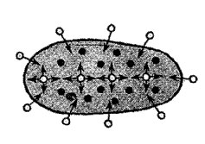
Boundary flooding
Boundary flooding is the most common type and can be used in oil fields that meet the following conditions:
On large deposits (both in terms of area and reserves)
In deposits that are heterogeneous in structure and reservoir properties
In reservoirs with reduced filtration characteristics
When oil viscosity increased
In carbonate reservoir
The main types of boundary flooding:
line flooding
pattern flooding
block flooding
axial flooding
spot selective flooding

Slide 7
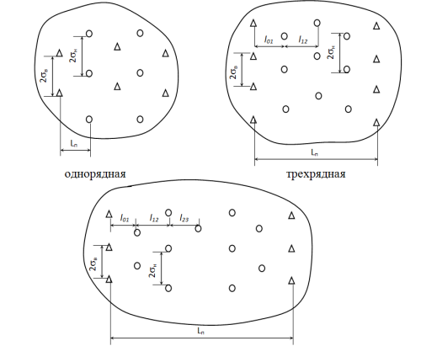
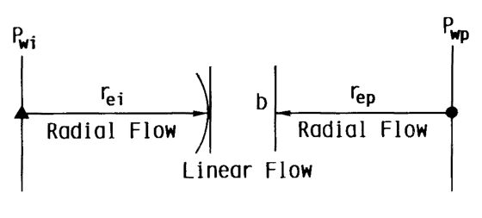
Line-drive flooding
An injection pattern in which the injection wells are located in a straight line parallel to the production wells.
Mechanism
Single-row
Three-row
Mostly this type is used for layer thickness heterogeneous
Five-row

Slide 8
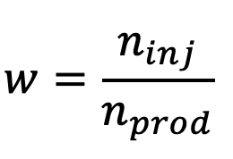
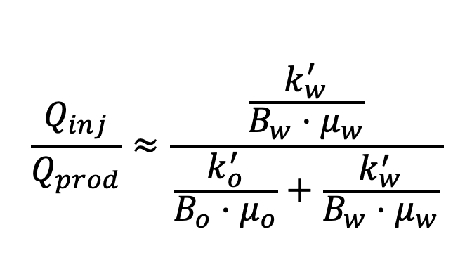
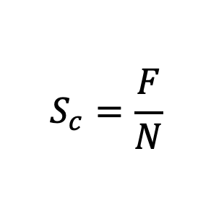
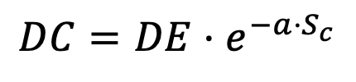
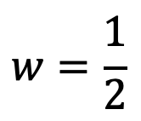
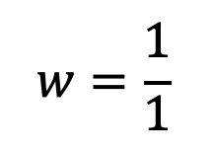
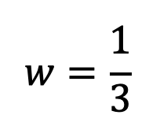
Pattern flooding
Four-spot
Seven-spot
Well grid density selection
Well grid density, m2/per well | Reservoir characterictics
(1-2)10⁴ | high oil viscosity, several hundered cP
(10-20)10⁴ | tight oil, 0.01-0.1 D
(25-64)10⁴ | large depth or sophisticated geology
(64-100)10⁴ | high production fields
Five-spot
Nine-spot

Slide 9
Conclusion
Well drilling is the most expensive operation in petroleum engineering
Reservoir injection scheme influences displacement coverage factor
The choice of flooding system determined by
type of reservoir,
size of the oil and water saturated parts,
type of reservoir rock,
fluid properties,
degree of heterogeneity,
reservoir quality

